Slide 1
March 29, 2014

Slide 2
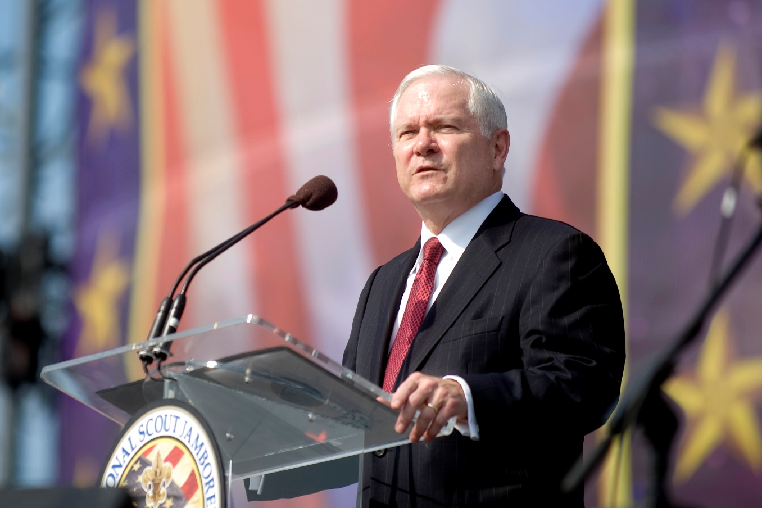
Quote of the month:
“It appears the greatest challenges are behind us. Still, it seems to me we have been, as a movement and as leaders of that movement, distracted, divided, and defensive.
Now it is time to refocus on the Scouts and on this unique program.”
Bob Gates
President-elect Boy Scouts of America
Notes:
The Boy Scouts of America’s president-elect, former U.S. Secretary of Defense Robert Gates, told the BSA leadership at the Feb. 5 meeting that he had “no intention of reopening the BSA membership standards issue” during his presidency. “Scouting has been through a divisive ordeal,” he said. “I fully support the decision that was made last May, but I believe strongly that we need now to focus on healing our differences, restoring our unity, and returning our full attention to growing our membership, strengthening our finances, and delivering a Scouting program of the highest quality.”
“It appears the greatest challenges are behind us. Still, it seems to me we have been, as a movement and as leaders of that movement, distracted, divided, and defensive.
Now it is time to refocus on the Scouts and on this unique program.”

Slide 3
COMMISSIONER General Updates

Slide 4
Annual Service Plan
April
Leadership Inventory
Commissioner Self-Evaluation
May
JTE Progress Review
Succession Planning for Troops
http://commissioner-bsa.org/service.html
Notes:
Don’t Miss This!

Slide 5
Looking Ahead
Train & Prepare Commissioner for June/July Unit Health Assessments
http://commissioner-bsa.org/health
Promote & Present Commissioner Awards
To Coincide with District Recognition Dinners
5
Notes:
Don’t Miss This!

Slide 6
Career Enhancement
Are you mentoring your Service Executive?
In working with the unit service executive, the correct orientation is to work with them as a peer.
It’s not uncommon for the DC to be older than the executive, but they should not relate to the district executive as a son or daughter; instead, they should relate as equals.
The DC should help the DE succeed. A common role for the district commissioner is to act as a mentor or coach to the district executive, working to develop a meaningful working relationship.
Council Commissioner Manual #522-015

Slide 7
#1 Priority
Frontier +11
Potomac District +9
Mingo Trails, Japeechen, Mon Valley +1
Rumors about
Seneca, Fort Bedford, Chief Logan

Slide 8
#2 Priority
Hold commissioning ceremonies
Look for reasons recognize publicly & privately
Encourage earning Commissioner Awards

Slide 9
#3 Priority
Monthly unit visits are the single most critical issue to ensure the delivery of a quality program to every unit in our council.

Slide 10
Unit Visit Coverage
January-February 2014
39
43
26

Slide 11
JTE Scorecard Unit Visitations
GOLD Districts
Mon Valley
Beaver Valley
General Greene
Seneca
Conestoga
Frontier
Chestnut Ridge
Japeechen
Steel City

Slide 12
JTE Scorecard Commissioner Service
GOLD Districts
Forbes Trail
Frontier
Beaver Valley
Steel City
Chestnut Ridge
Lackawanna
Mon Valley
Japeechen
Mingo Trails

Slide 13
Council JTE Scorecard

Slide 14
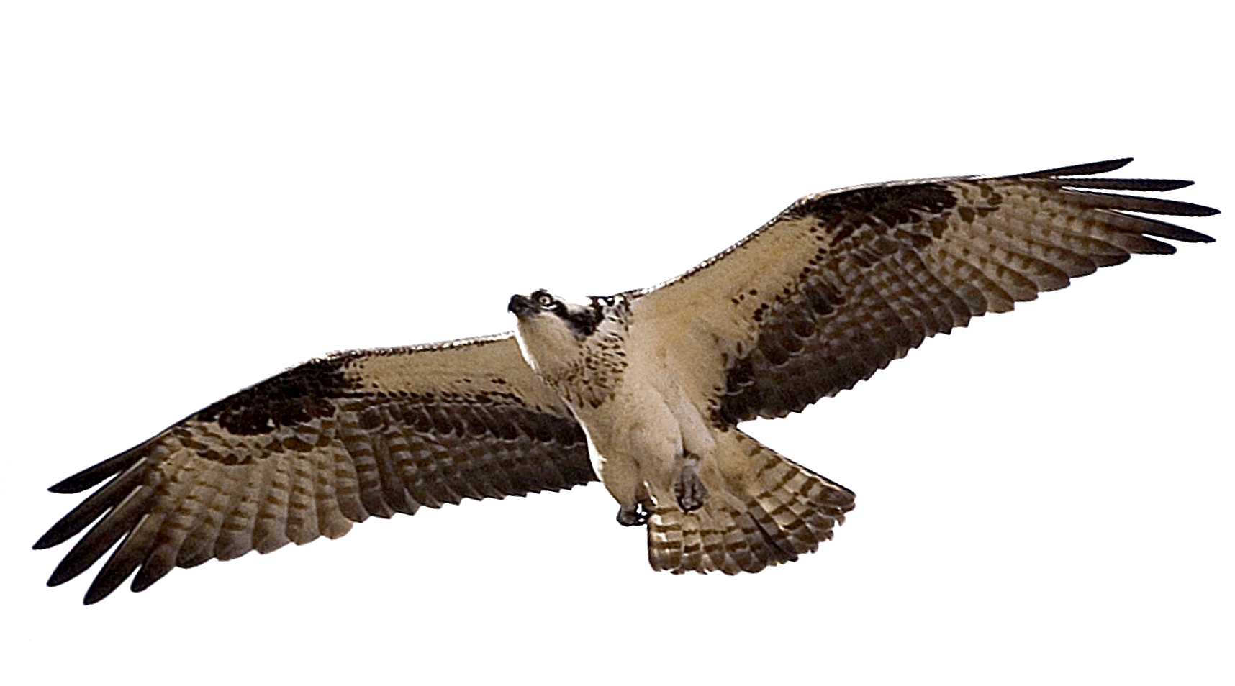
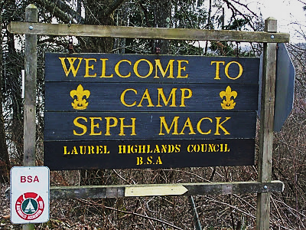
Commissioner Conference
June 7 Camp Seph Mack
Steak & Shrimp Dinner
Team Building & Fun
DCSA Presentation
June Cabinet Meeting
Basic & Advanced Training

Slide 15
Commissioner Nite @ Pittsburgh Pirates
Wednesday, April 2
FREE

Slide 16
Commissioner Nite @ Washington Wild Things
Sunday, August 24
$15 includes Tailgate Party

Slide 17
Commissioner Toolbox

Slide 18
COMMISSIONER Training Updates

Slide 19
COMMISSIONER Training Updates
Kudos to Jack Boyde & Bob Reese
College of Commissioner Science Degree Recipients

Slide 20
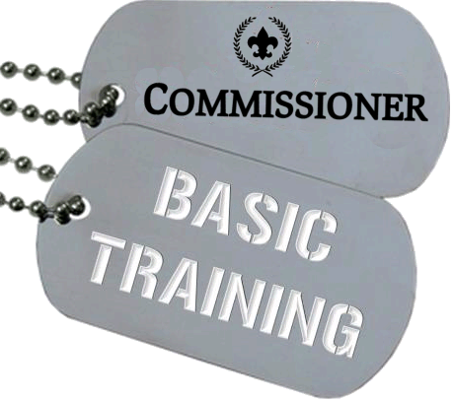
COMMISSIONER Training Updates
• April 12, 2014 – Sponsored by Area 4 8:30 AM Flag Plaza
June 7, 2014 – Sponsored by Area 6 8:30 AM (Part of Commissioner Conference)

Slide 21
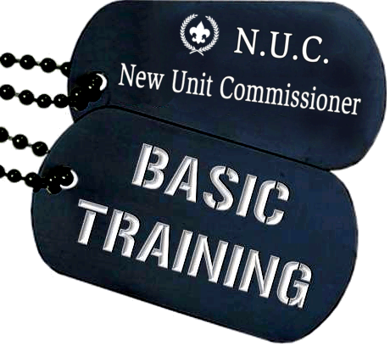
COMMISSIONER Training Updates
April 12, 2014 – Council Led 8:30 AM Flag Plaza

Slide 22
COMMISSIONER Training Updates
June 7, 2014 – Council Led 8:30 AM (Part of Commissioner Conference)

Slide 23
COMMISSIONER Training Updates
Training before April 15 Cabinet Meeting
6:00 PM

Slide 24
COMMISSIONER Recognition
Boys’ Life
Alan Hazelwood

Slide 25
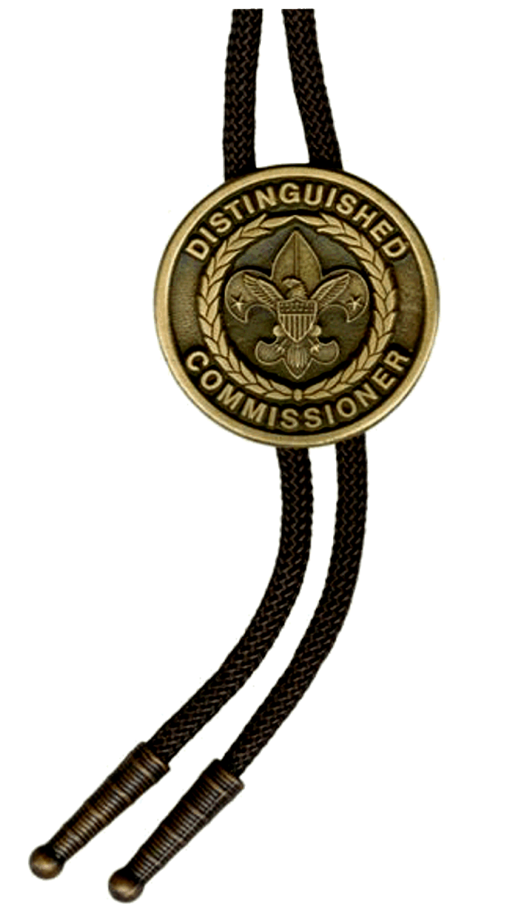
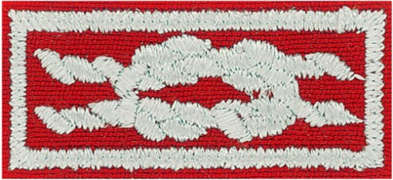
COMMISSIONER Recognition
PLEASE NOMINATE!
D.C.S.A.
Distinguished Commissioner Service Award
New forms – New deadline – May 1
http://dcsa.commissioner-bsa.org
PRESENTATION @ COMMISSIONER CONFERENCE

